Slide 1
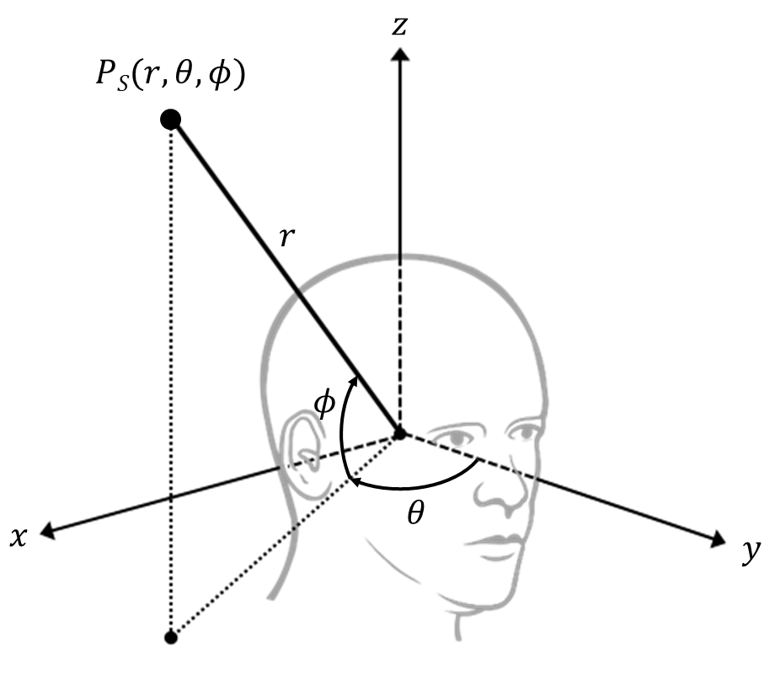
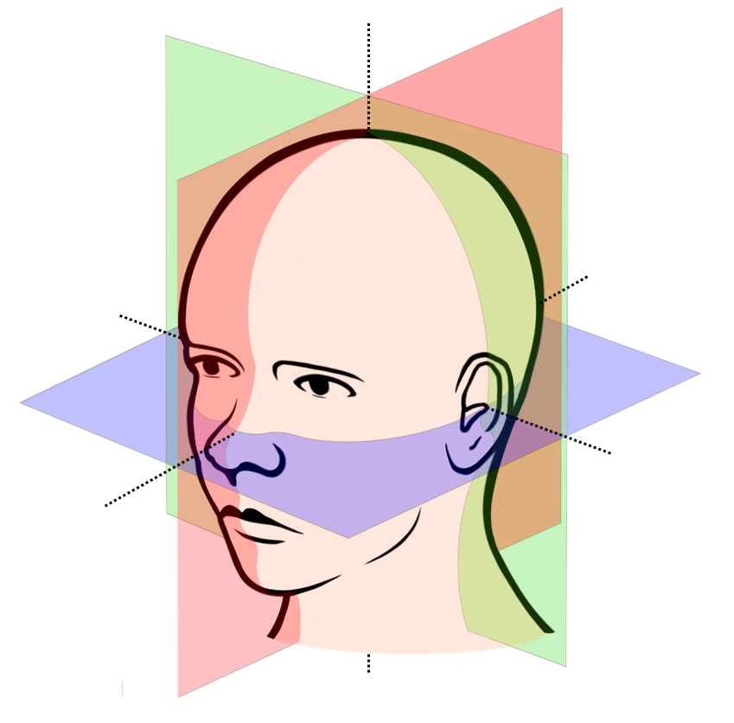
Median
plane
Lateral
plane
Horizontal
plane

Slide 2
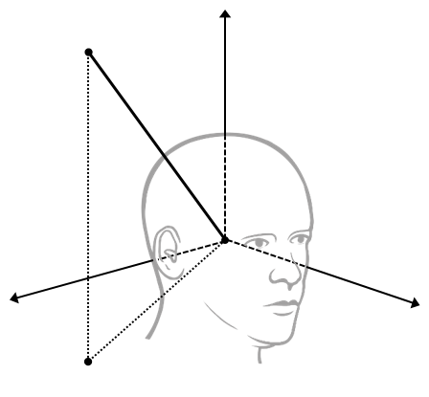
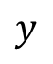
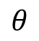
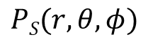
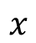
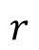
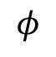
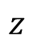
$$z$$
$$PS(r,θ,φ)$$
$$r$$
$$φ$$
$$θ$$
$$x$$
$$y$$

Slide 5
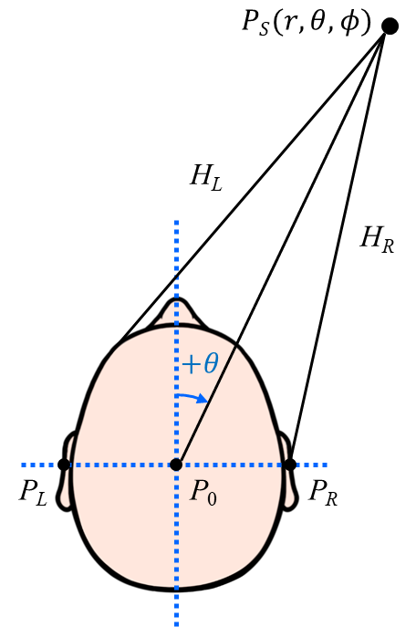
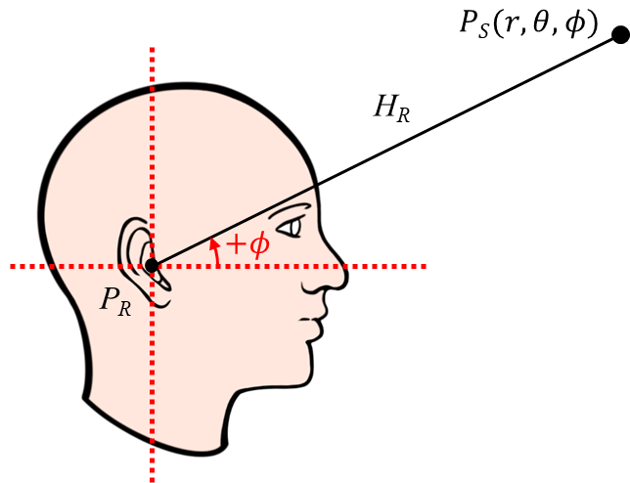

Slide 6
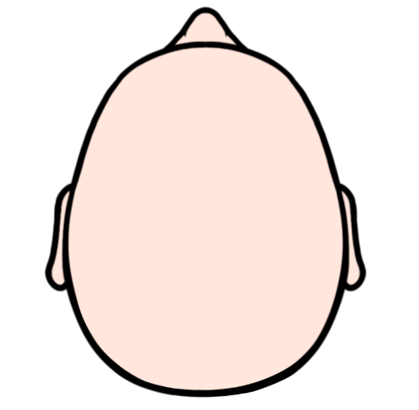
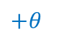
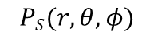
$$PS(r,θ,φ)$$
H_{L}
H_{R}
$$+θ$$
P_{L}
P₀
P_{R}

Slide 7
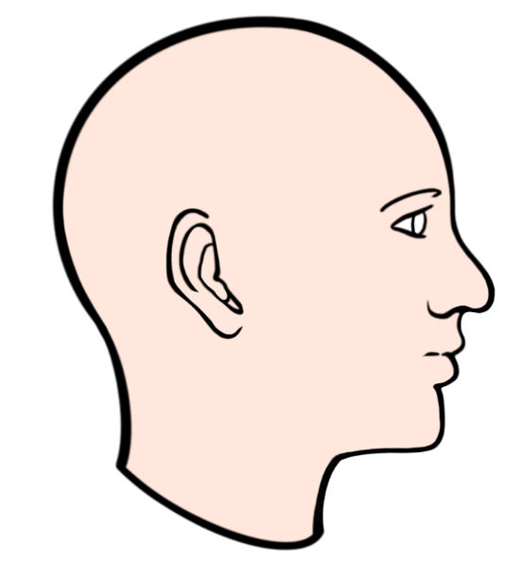
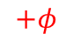
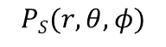
$$PS(r,θ,φ)$$
H_{R}
$$+φ$$
P_{R}

Slide 9

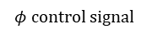
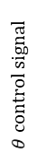
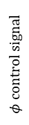
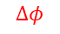
Speaker selector
$$Δφ$$
Speaker array
Speaker amplifier
︙
︙
$$φ control signal$$
Host
computer
DOA
controller
Microphones
Speaker array
Audio interface
$$φ control signal$$
$$θ control signal$$
Servo motor
Speaker amplifier
Microphone
conditioner
$$Δθ$$
Turntable
Speaker
selector

Slide 13
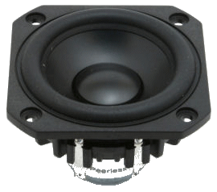

Slide 15
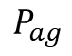
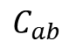
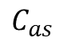
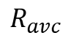
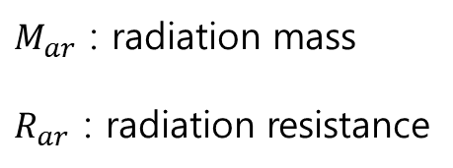
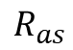
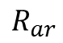
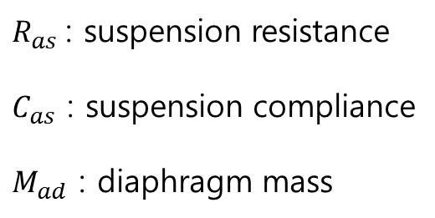
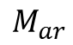
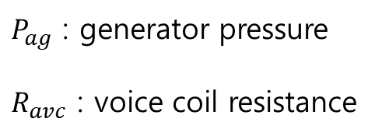
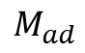
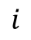
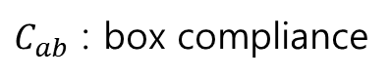
$$i$$
$$R_{as}$$
$$C_{as}$$
$$M_{ad}$$
Mechanical elements of speaker driver
$$R_{avc}$$
$$M_{ar}$$
Electrical elements of speaker driver
Radiation elements of speaker driver
+
−
$$P_{ag}$$
Mechanical element of speaker box
$$R_{ar}$$
$$C_{ab}$$
$P_{ag}$ : generator pressure
$R_{avc}$ : voice coil resistance
$R_{as}$: suspension resistance
$C_{as}$ : suspension compliance
$M_{ad}$ : diaphragm mass
$M_{ar}$ : radiation mass
$R_{ar}$ : radiation resistance
$C_{ab}$ : box compliance

Slide 16
Resistor Symbol
Inductor Symbol
10mA
Capacitor Symbol
+
-
1KΩ
10V

Slide 18
116 Hz

Slide 20
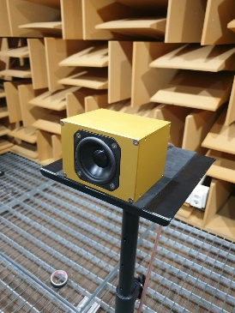
119 Hz

Slide 21
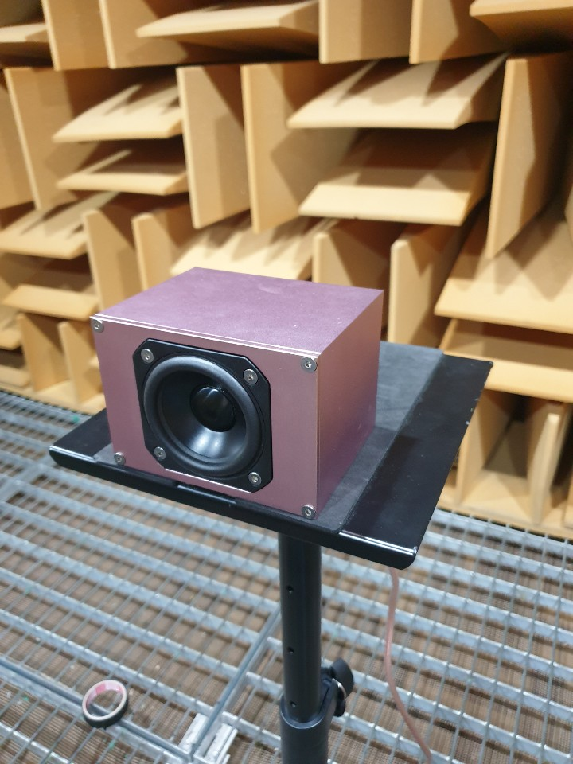
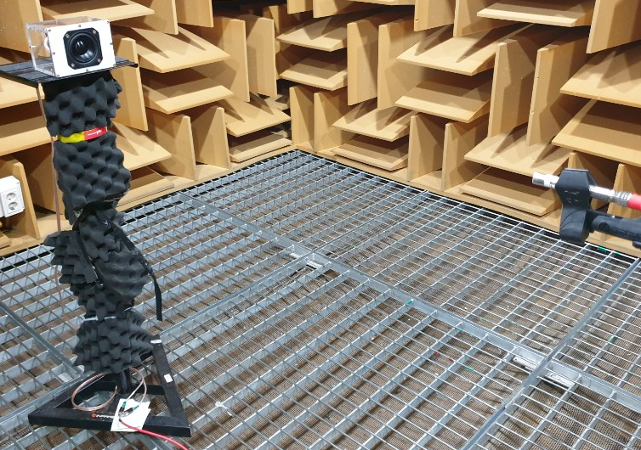

Slide 23
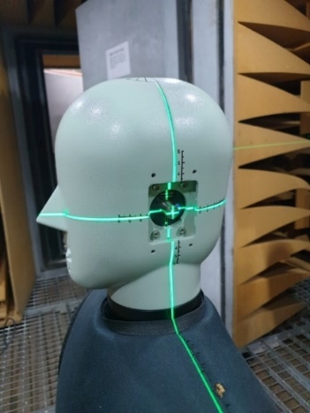
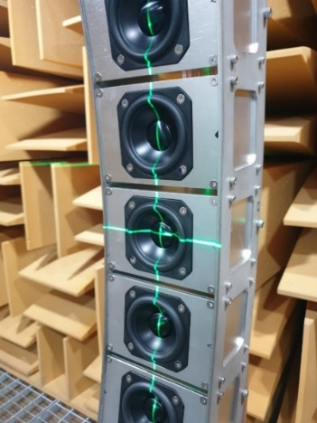
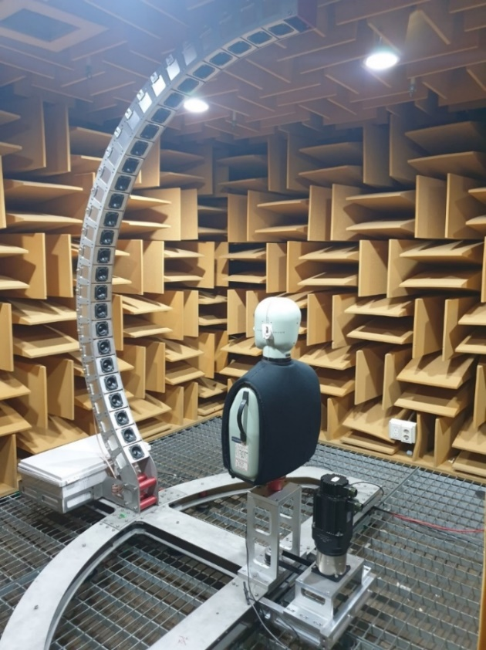
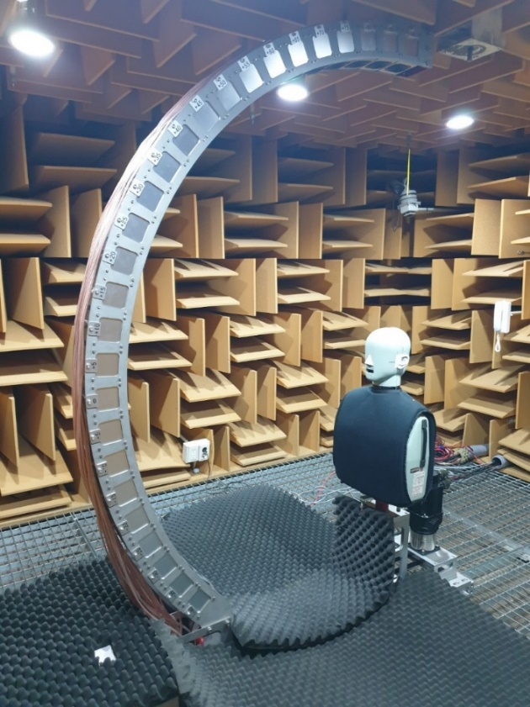

Slide 24
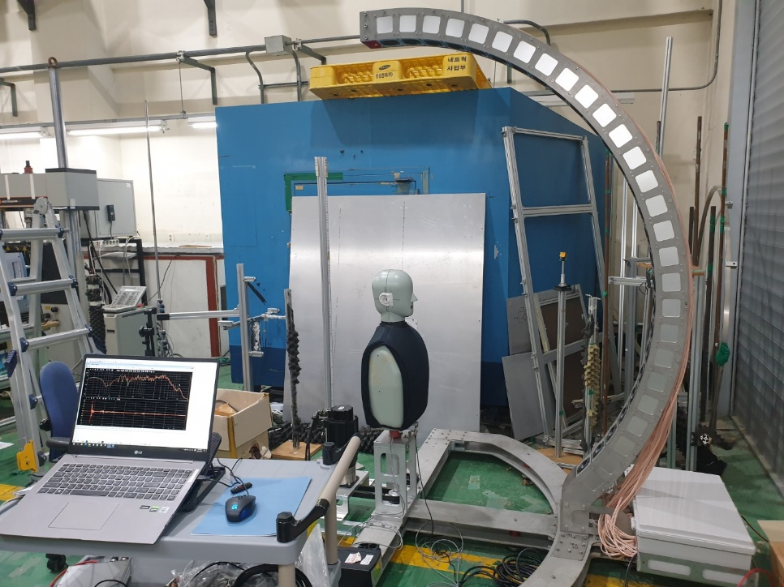
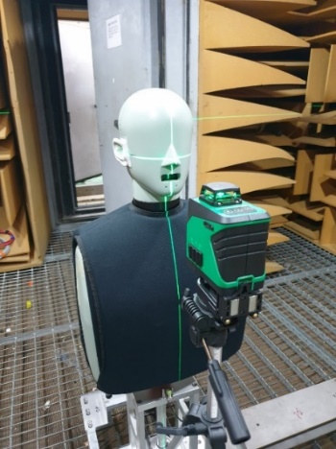
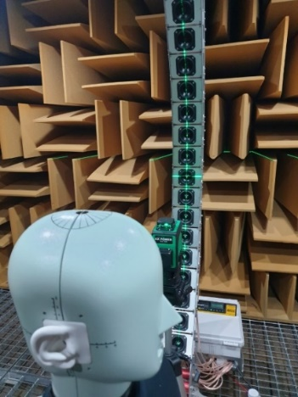

Slide 26
Contralateral
Ipsilateral
Ipsilateral
Contralateral
Head shadow
Contralateral
Ipsilateral
Head shadow
Ipsilateral
Contralateral
Contralateral
Excessive phase change
Ipsilateral
Excessive phase change
Ipsilateral
Contralateral

Slide 28
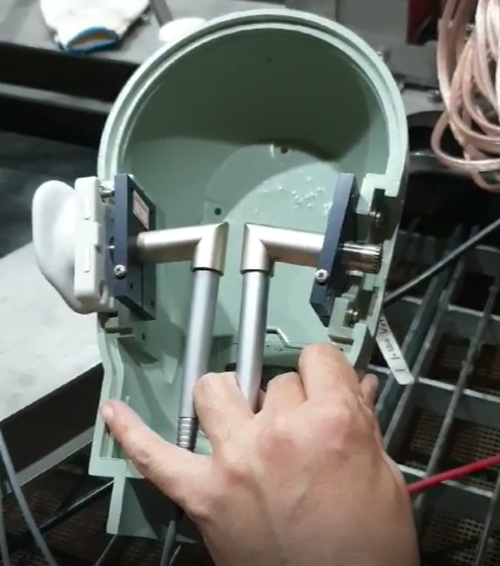
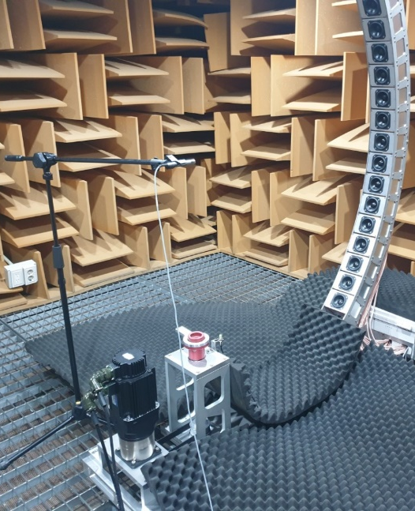

Slide 29
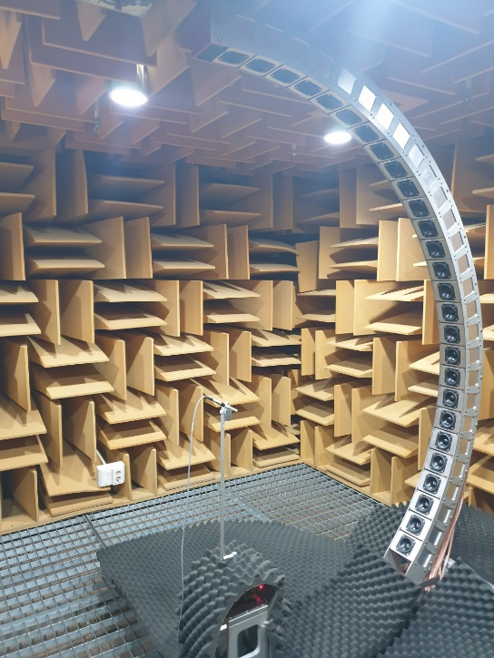
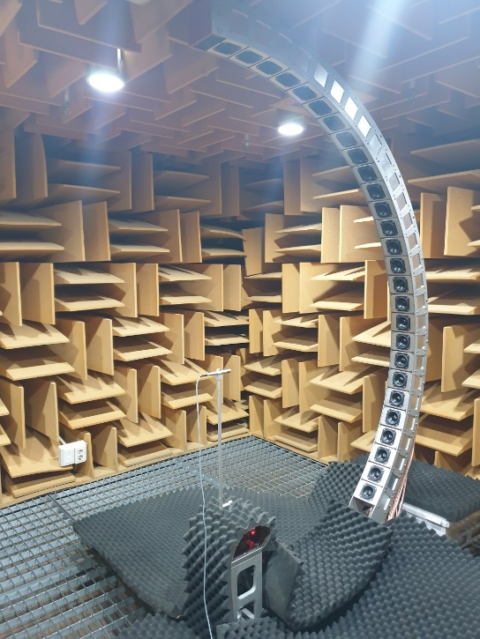




Slide 31


Microphone 90° off-axis
Microphone 0° on-axis

Slide 32
Microphone 90° off-axis
Microphone 0° on-axis

Slide 35



Slide 36
−40˚ ~ −15˚
−10˚ ~ +15˚
+20˚ ~ +45˚

Slide 37
+50˚ ~ +75˚
+80˚ ~ +90˚

Slide 38



Slide 40



Left Ipsilateral 90°
Right Ipsilateral 90°
Head shadow
Head shadow
$$g_{L}\left(−90,0,t\right)$$
$$g_{R}\left(+90,0,t\right)$$
※ 1.1 m → 3.2353 ms ( c = 340 m/s )

Slide 42

④ 1.02 m $×$ 3 = 3.06 m → 9.0 ms
Reflection from the speaker array
④
③
②
Time window
①
① 2.28 m → 6.7 ms
② 2.72 m → 8.0 ms
③ 3.00 m → 8.8 ms
Reflection from the floor

Slide 44











$$S(r,θ,φ)$$
$$H_{L, R}=\frac{P_{L, R}}{P_{0}}$$
H_{L}
H_{R}
$$θ$$
P_{L}
P₀
P_{R}
l
Circular shifted
by at least $l/c$
$$τ_{R}\left(ω\right)<0$$
$$τ_{L,R}\left(ω\right)=−\frac{dΨ_{L,R}\left(ω\right)}{dω}$$
$$τ_{R}\left(ω\right)>0$$
$$τ_{L}\left(ω\right)>0$$
$l$ : radius of the head
$c$ : speed of sound in air
$$τ_{L}\left(ω\right)>0$$

Slide 46

$$H_{L,R}\left(0,φ,f\right)$$

Slide 47

Contralateral
Ipsilateral
Contralateral
Head shadow
Ipsilateral
Contralateral
Excessive phase change
Ipsilateral
$$H_{L,R}\left(45,φ,f\right)$$

Slide 48

Contralateral
Ipsilateral
Contralateral
Head shadow
Ipsilateral
Contralateral
Excessive phase change
Ipsilateral
$$H_{L,R}\left(90,φ,f\right)$$

Slide 49

Contralateral
Ipsilateral
Contralateral
Head shadow
Ipsilateral
Contralateral
Excessive phase change
Ipsilateral
$$H_{L,R}\left(135,φ,f\right)$$

Slide 51

Contralateral
Ipsilateral
Ipsilateral
Contralateral
Head shadow
Contralateral
Ipsilateral
Head shadow
Ipsilateral
Contralateral
Contralateral
Excessive phase change
Ipsilateral
Excessive phase change
Ipsilateral
Contralateral
$$H_{L,R}\left(θ,0,f\right)$$

Slide 52

Contralateral
Ipsilateral
Ipsilateral
Contralateral
Head shadow
Contralateral
Ipsilateral
Head shadow
Ipsilateral
Contralateral
Contralateral
Excessive phase change
Ipsilateral
Excessive phase change
Ipsilateral
Contralateral
$$H_{L,R}\left(θ,30,f\right)$$

Slide 53

Contralateral
Ipsilateral
Ipsilateral
Contralateral
Head shadow
Contralateral
Ipsilateral
Head shadow
Ipsilateral
Contralateral
Contralateral
Excessive phase change
Ipsilateral
Excessive phase change
Ipsilateral
Contralateral
$$H_{L,R}\left(θ,60,f\right)$$

Slide 54

$$H_{L,R}\left(θ,90,f\right)$$

Slide 56
Causal HRTF

Slide 57
Non-causal HRTF

Slide 63
P1
N1
P2
N2
OTF measurement by
0° on-axis mic
Back
Front

Slide 64
P1
N1
P2
N2
OTF measurement by
90° off-axis mic
Back
Front

Slide 67


